Slide 1

CS 533 INTRO TO DATA SCIENCE
Michael Ekstrand

Slide 2
TYPES OF CHARTS

Slide 3

Learning Outcomes
Identify the appropriate type of chart for data and a question
Understand key rules to avoid common errors
Photo by KOBU Agency on Unsplash

Slide 4
Software
Seaborn (sns)
Matplotlib (plt)
Plotnine / ggplot2 (pn)

Slide 5
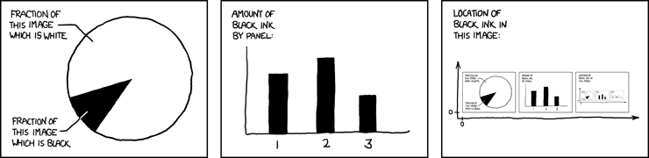
Chart Types
XKCD #688, ⓒ Randall Monroe. Used under CC-BY-NC

Slide 6
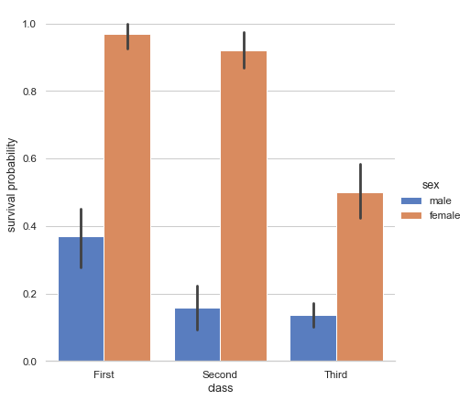
Bar Charts
Titanic Passenger Survival Rates by Gender and Passage Class
Show numeric values grouped by a categorical (or ordinal) variable
Best with moderate number of categories
Can have second categorical in bar color
Y often mean, sum, or count within group
Can rotate to horizontal bar
Whiskers: confidence interval
From Seaborn gallery

Slide 7
Bar Charts
Titanic Passenger Survival Rates by Gender and Passage Class
Functions:
sns.countplot (count by category)
sns.catplot (mean by category)
plt.bar
pn.geom_bar
From Seaborn gallery

Slide 8
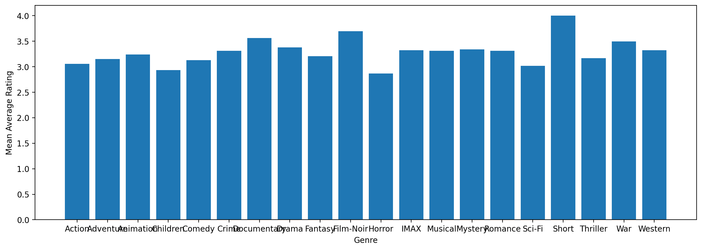
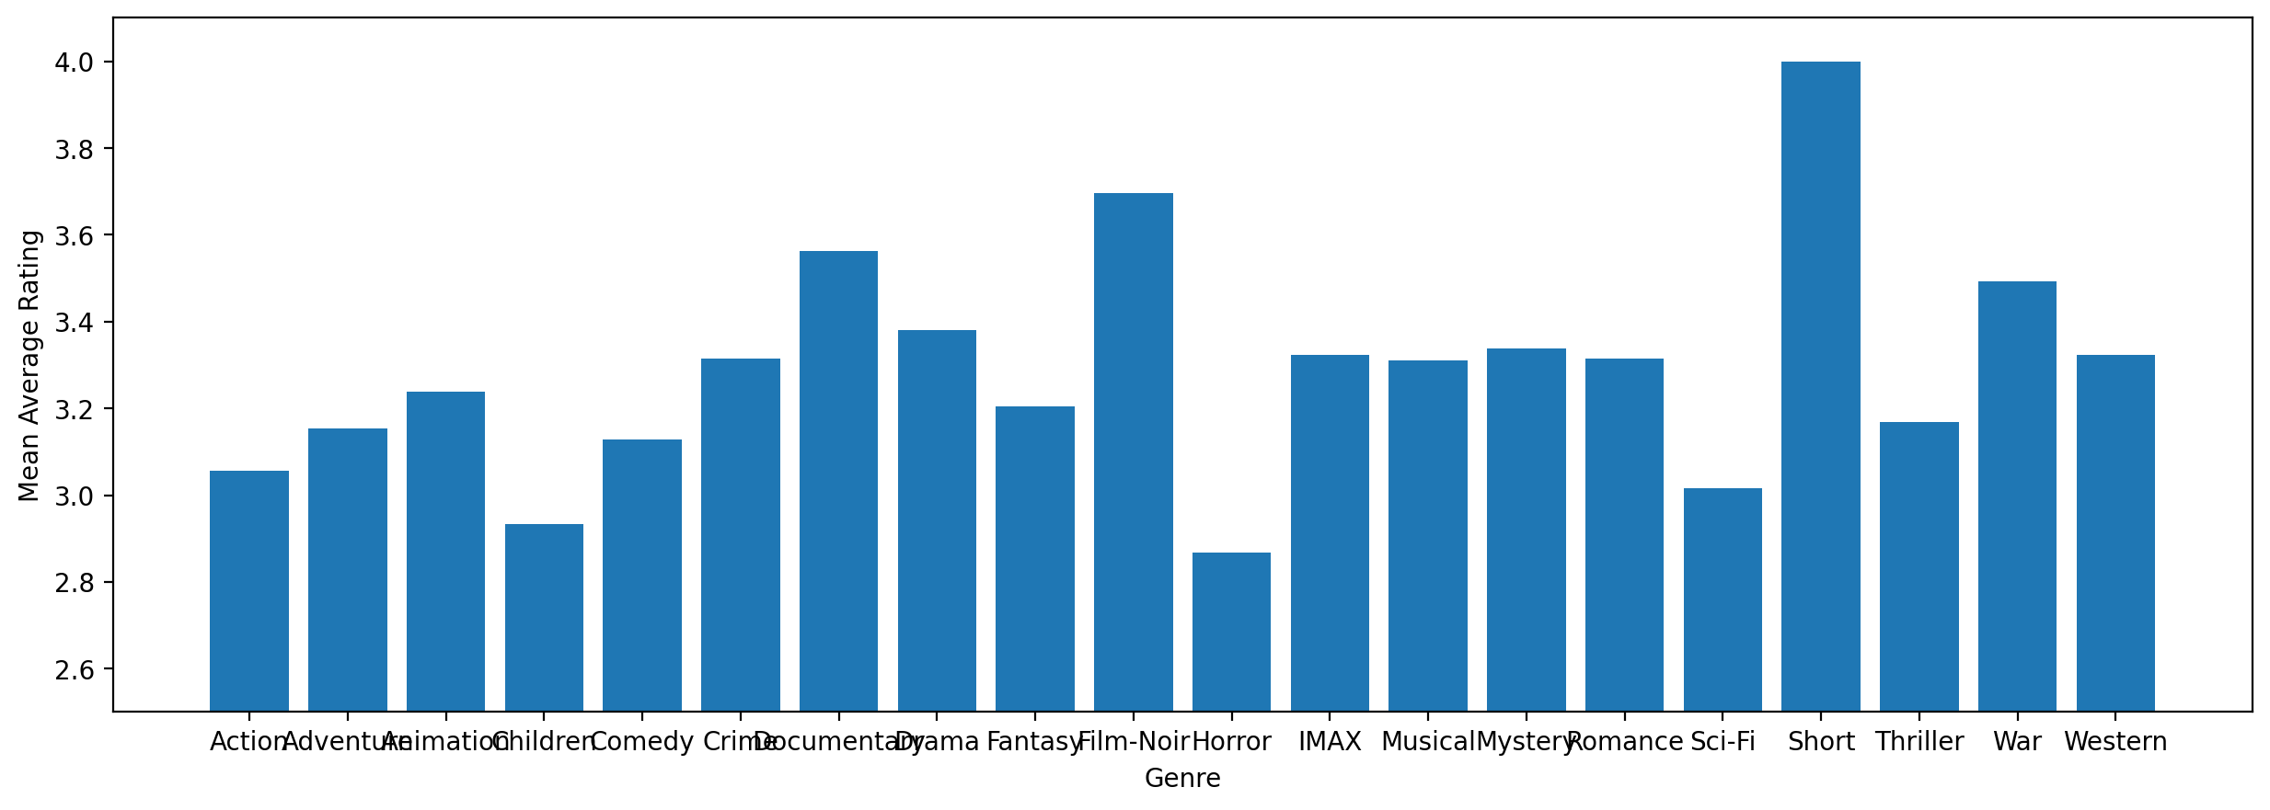
Bar Chart Rules
Never start y axis at anything but 0 – skews relative sizes
If including whiskers: define how they are computed
If using SNS catplot or countplot without a color group: set color, or they’ll recolor for no reason.

Slide 9
Histograms
Bar chart where ‘categorical’ is bins of a numeric value.
Bar chart showing relative frequency of categorical values also a histogram
Y is either number or fraction of occurrences
Goal is to see relative frequency of different values
One way to graphically describe a distribution.

Slide 10
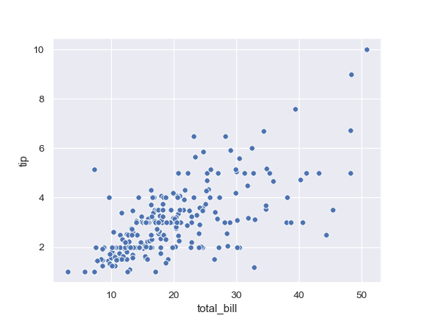
Scatter Plots
Shows two numeric values
Observations have two numeric variables
Want to see how they relate
Does one increase with the other?
Do points clump in space?
Are there other patterns? Outliers?
Restaurant Tips and Bills
From Seaborn documentation

Slide 11
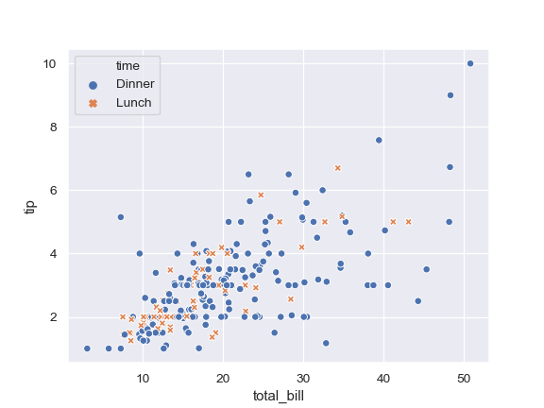
Refinements
Color by categorical variable
Plot a trend or context line (not shown)
X can be categorical (point plot or strip plot)
Functions:
plt.scatter
sns.scatterplot
pn.geom_point
Restaurant Tips and Bills
From Seaborn documentation

Slide 12
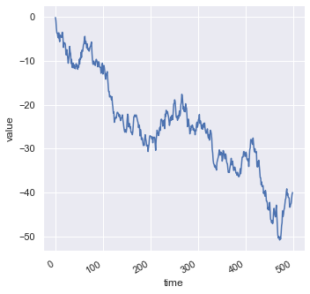
Line Plots
Two numeric values
One y per x value
Emphasizes progression (or continuity) from one to the next
Very common for time series
Functions
sns.lineplot
plt.line
pn.geom_line
From Seaborn tutorial

Slide 13
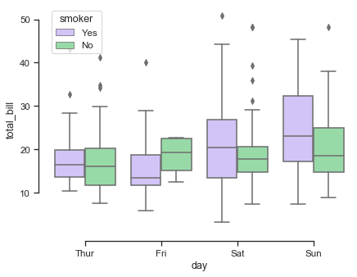
Box Plots
Show distribution of numeric variable grouped by categorical
Median
Quartiles
Min/max
Outliers (in much software)
Functions:
sns.boxplot
plt.boxplot
pn.geom_box
From Seaborn gallery

Slide 14
More Plot Types
Violin plots (like box, but mean-based)
Swarm plots (categorical scatter plot)
Pie (usually best avoid – bar or stacked bar)
Donut
Rug (displaying distribution in a margin)

Slide 15
Learning More
Class readings
Textbook
Seaborn and Matplotlib docs
Tutorials
Gallery

Slide 16

Wrapping Up
Many types of charts.
Learning good graphics techniques takes time and practice.
Review plotting library galleries!
Photo by Edgar Chaparro on Unsplash

